Slide 1







Analysis of Emerging Technologies and Desirable Skills
Philip Tegg
21-Jul-2022

Slide 2



OUTLINE
Executive Summary
Introduction
Methodology
Results
  Visualization – Charts
  Dashboard
Discussion
  Findings & Implications
Conclusion
Appendix

Slide 3

EXECUTIVE SUMMARY
The purpose of this analysis is to identify trends in emerging technologies in order to determine future IT skill requirements.
Data was collected from the Github Jobs API, as well as the Stack Overflow Developer Survey.
Most popular current technologies:
  Language – Javascript
  Database - MySQL
  Platform – Linux
  Web Framework – jQuery
Most desirable technologies for next year:
  Language – Javascript
  Database – PostgreSQL
  Platform - Linux
  Web Framework – React.js
Recommended most desirable new skills :
  Database – PostgreSQL
  Web Framework – React.js

Slide 4

INTRODUCTION
The purpose of this analysis was to look at the most popular technologies used in IT and determine what new technologies are emerging, and hence which new skills are desirable.
Key Questions to answer:
  What are the top programming languages in demand?
  What are the top database skills in demand?
  What are the top IDEs?
The information will be gathered from multiple sources:
  Job postings
  Training Portals
  Surveys

Slide 5

METHODOLOGY
Data Collection
  Job openings for technologies were collected from the GitHub Jobs API.
  Salary data were gathered from job postings via Web Scraping.
  Survey data from Stack Overflow on current and desired technologies were queried from a database.
Data Wrangling
  Duplicates rows were removed from the data.
  Missing values for work locations were determined.
  Salary data were normalized.
Exploratory Data Analysis
  The distribution of salaries and ages were explored.
  Outliers for salaries and age were found.
  Correlations between age and other categories were measured.
Visualisation of The Data
  Distributions – a histogram and box plot were both created for Age.
  Relationship – a scatter plot for Age vs WorkWeekHrs,
      a bubble plot for Age vs WorkWeekHrs and CodeRevHrs.
  Composition – a pie chart was created to show the top 5 most desirable languages for next year,
        a stacked column chart showed median WorkWeekHrs and median CodeRevHrs vs Age.
  Comparison – a line chart shows the median salary by Age, and a column chart shows MainBranch.
Dashboard
  A dashboard was created in Cognos to visualize current technology usage, future trends, and demographics.
This Presentation

Slide 6
RESULTS

Slide 7
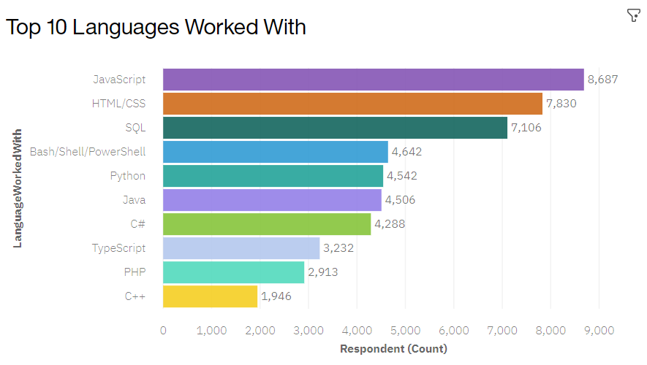
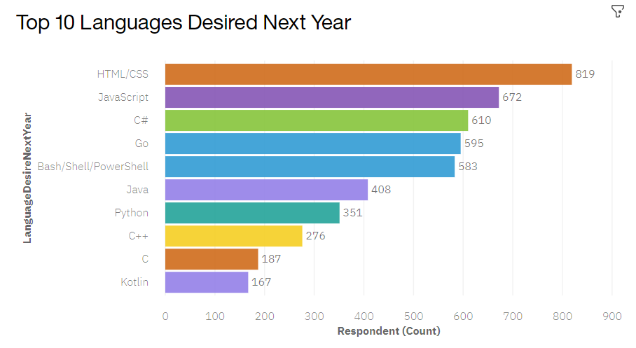
PROGRAMMING LANGUAGE TRENDS
Please note that Top 5 languages is a typo, Malika in the forums confirmed that submitting top 5 or 10 is acceptable – link.
Current Year
Next Year

Slide 8
PROGRAMMING LANGUAGE TRENDS - FINDINGS & IMPLICATIONS
Findings
Finding 1
Finding 2
Finding 3
Implications
Implication 1
Implication 2
Implication 3

Slide 9
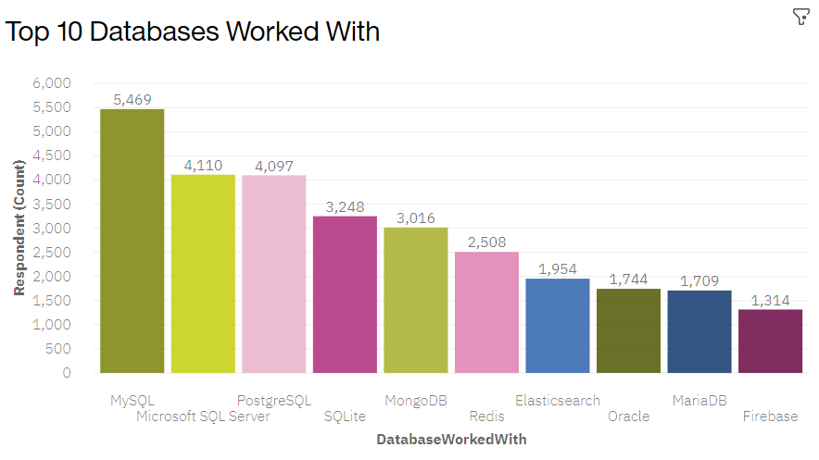
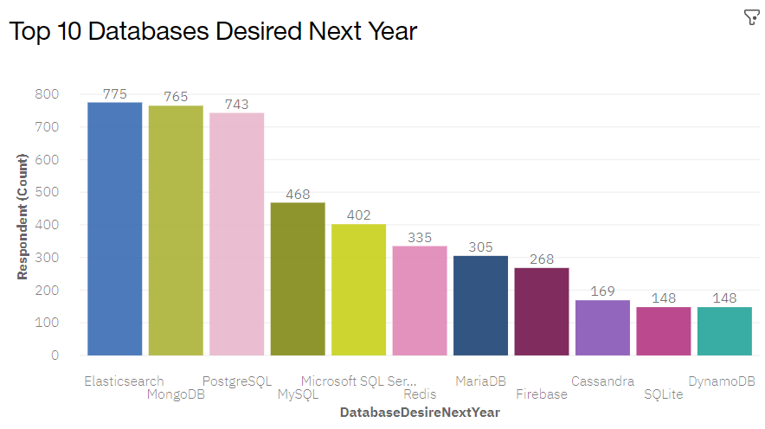
DATABASE TRENDS
Please note that Top 5 databases is a typo, Malika in the forums confirmed that submitting top 5 or 10 is acceptable – link.
Current Year
Next Year

Slide 10
DATABASE TRENDS - FINDINGS & IMPLICATIONS
Findings
Finding 1
Finding 2
Finding 3
Implications
Implication 1
Implication 2
Implication 3

Slide 11

DASHBOARD
https://dataplatform.cloud.ibm.com/dashboards/1147da06-8278-4bb9-84c8-5dcfc5a7e199/view/7e1dfe1962ea3cd64acfc8e407cb24027f35240cb2bb845689837b495c692397a8384291c8261a0cde135430a0b9410a98

Slide 12
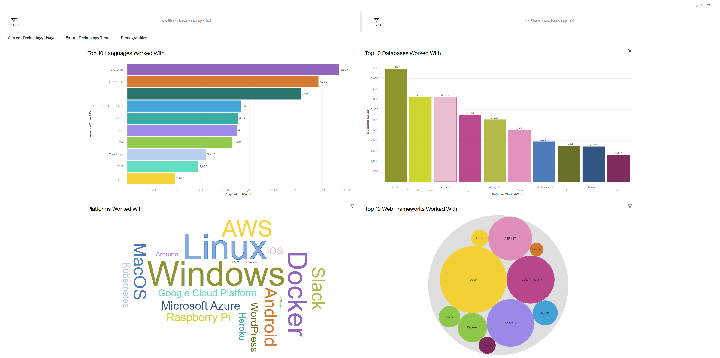
DASHBOARD TAB 1

Slide 13
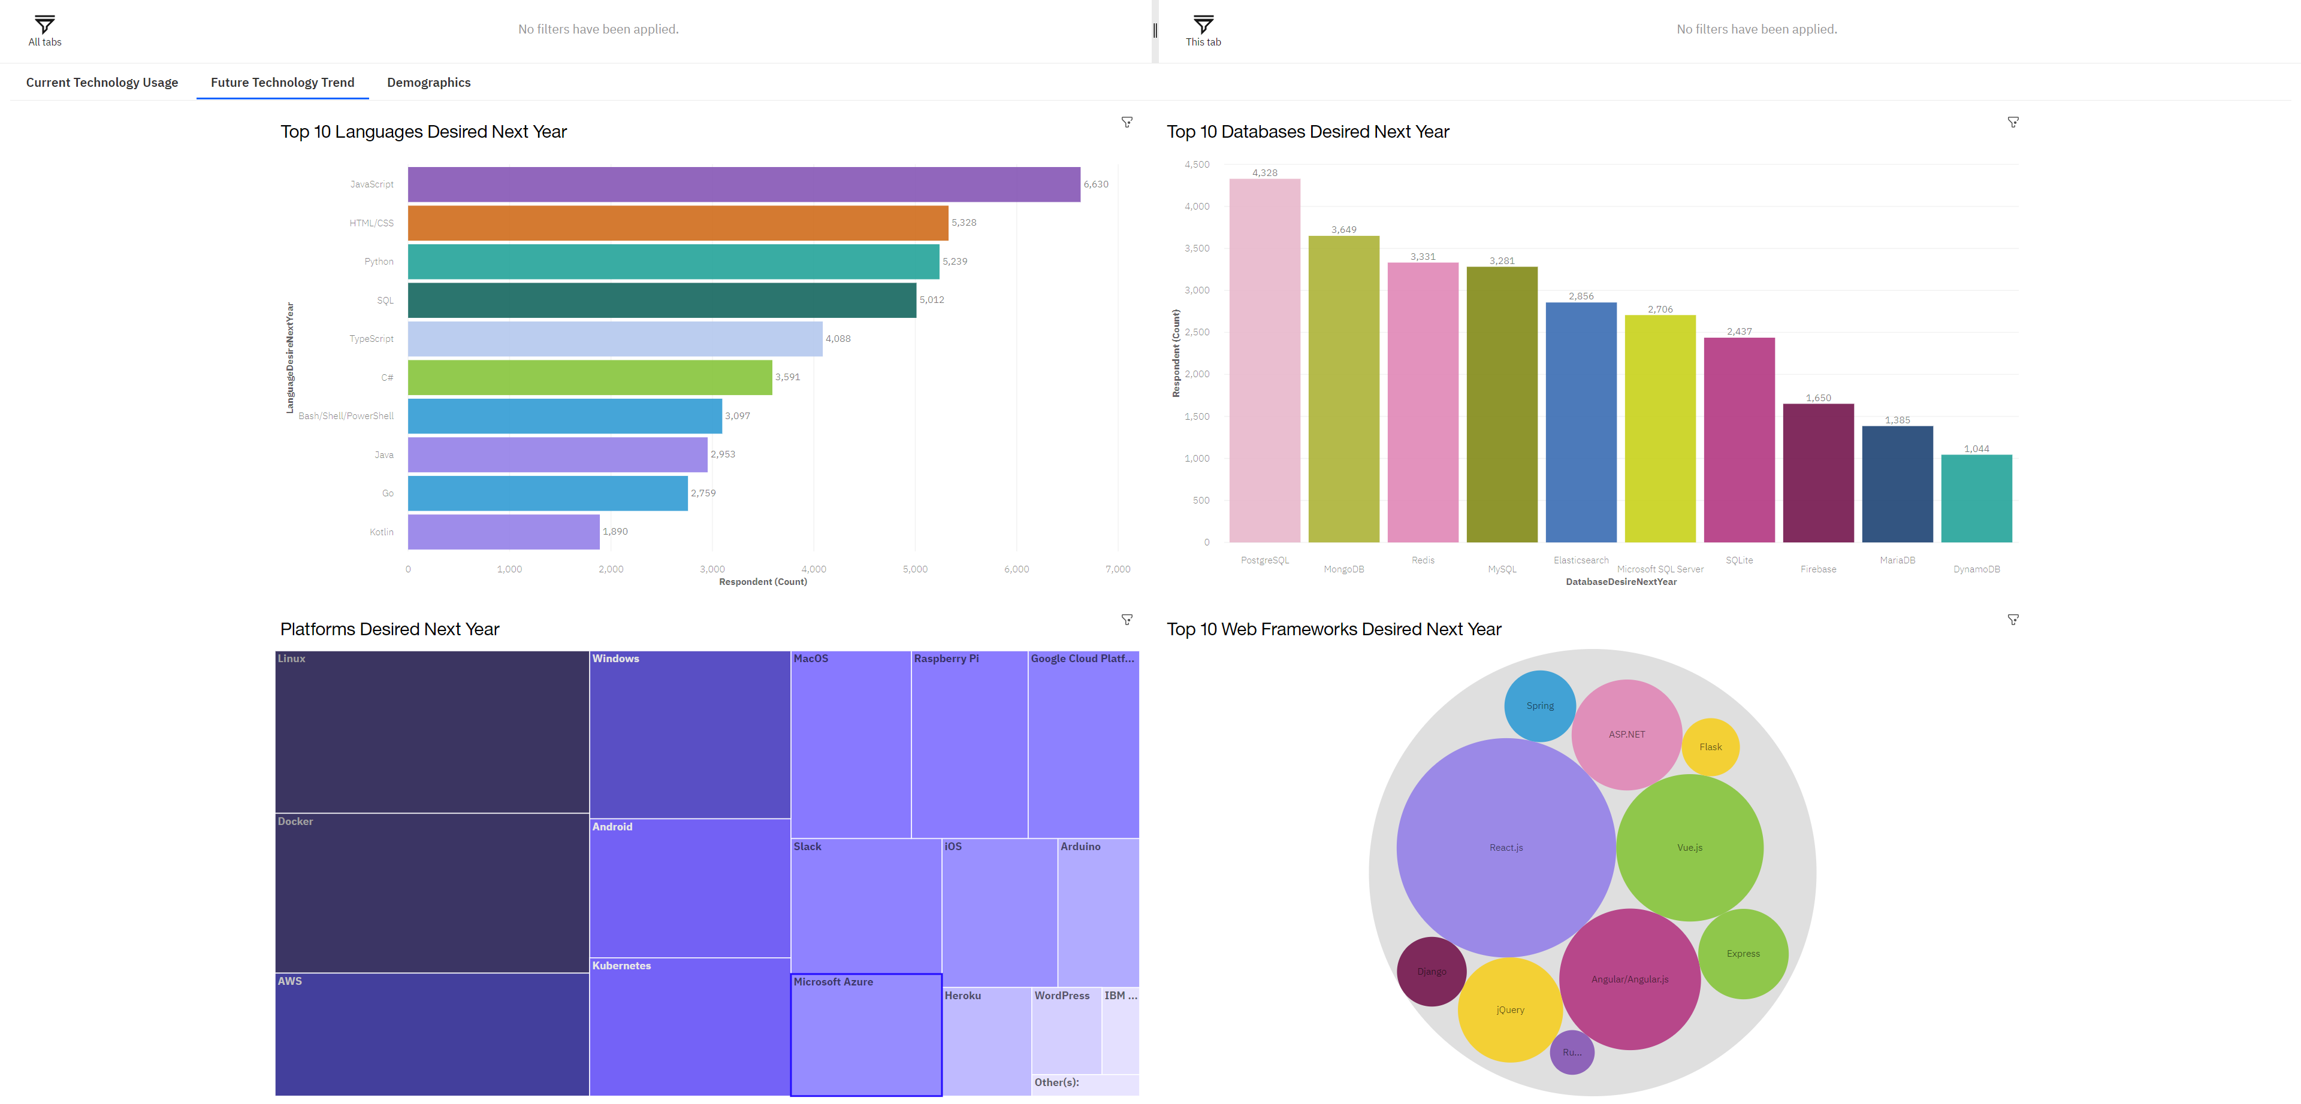
DASHBOARD TAB 2

Slide 14
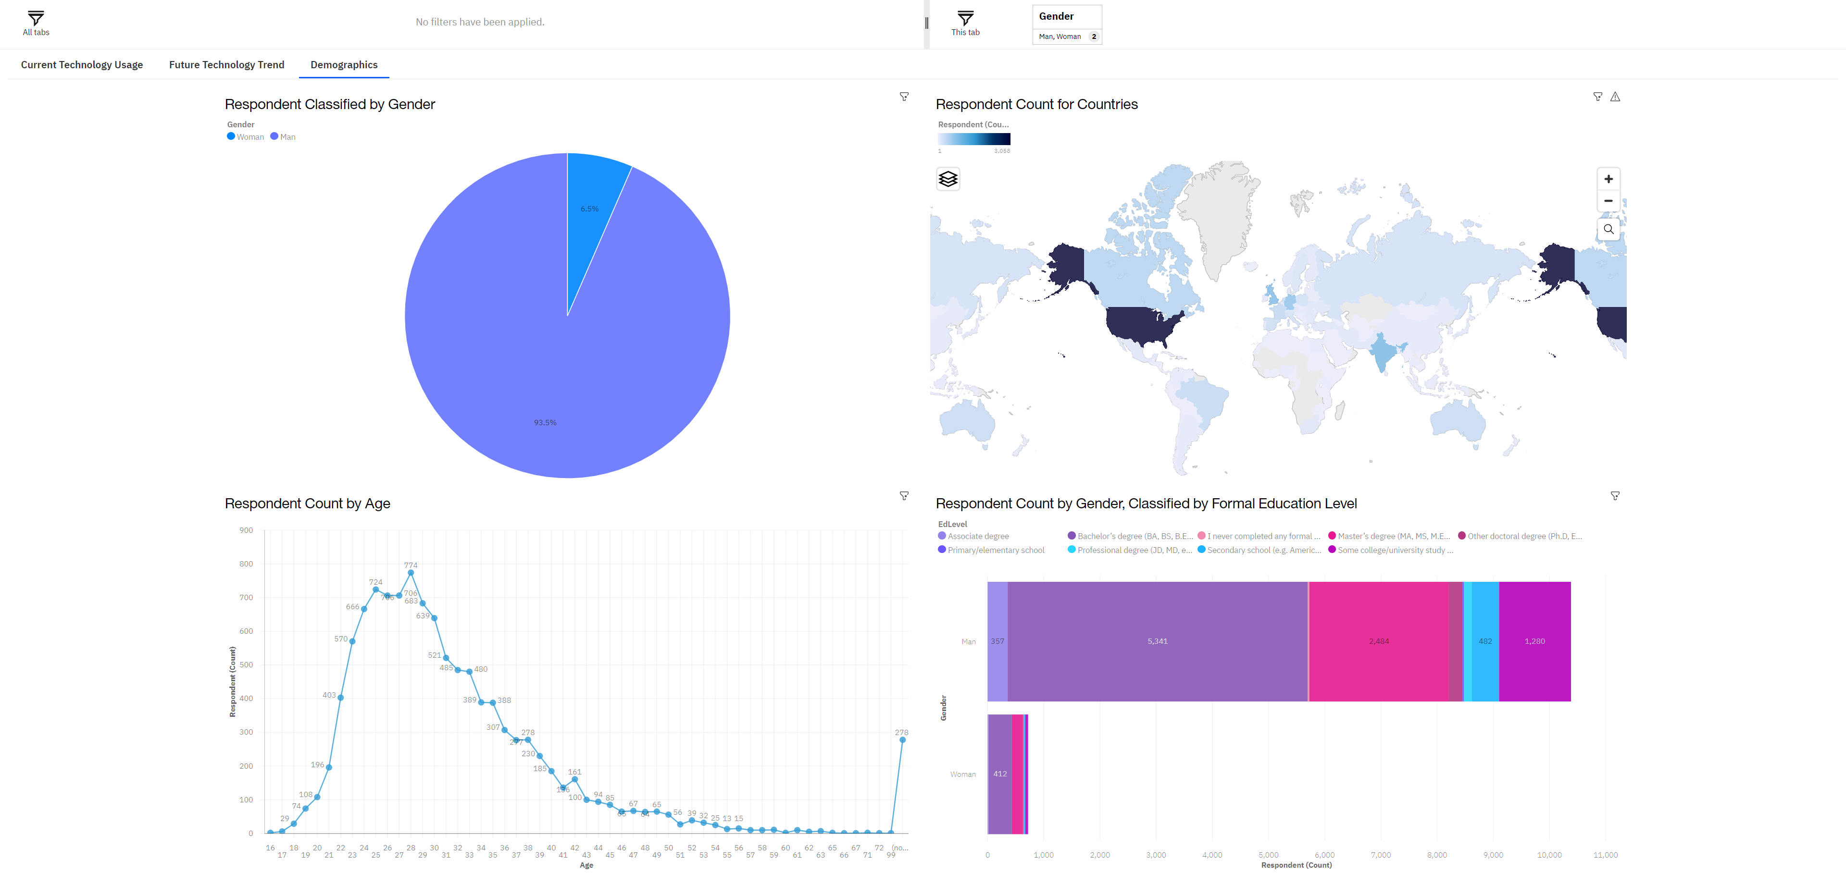
DASHBOARD TAB 3

Slide 15
DISCUSSION

Slide 16
OVERALL FINDINGS & IMPLICATIONS
Findings
Finding 1
Finding 2
Finding 3
Implications
Implication 1
Implication 2
Implication 3

Slide 17

CONCLUSION
Point 1
Point 2
Point 3
Point 4

Slide 18

APPENDIX
Include any relevant additional charts, or tables that you may have created during the analysis phase.

Slide 19
JOB POSTINGS
In Module 1 you have collected the job posting data using Job API in a file named “job-postings.xlsx”. Present that data using a bar chart here. Order the bar chart in the descending order of the number of job postings.

Slide 20
POPULAR LANGUAGES
In Module 1 you have collected the job postings data using web scraping in a file named “popular-languages.csv”. Present that data using a bar chart here. Order the bar chart in the descending order of salary.

